Slide 1







analyzing
Movies Data
Presented by: Jayesh Salunke

Slide 2

INDEX
Why Movie Data Matters
Business Objectives
Website Interface
Data Collection Strategy
Feature Extracted
Data Cleaning
Univariate Analysis (Rating Distribution and Runtime Boxplot)
Bivariate Analysis (Average Runtime and Rating Over the Years)
Bivariate Analysis (Top 10 Studios by Average Rating and Top 10 Directors by Number Of Movies)
Multivariate Analysis (Heatmap)
Conclusion

Slide 3

Why movie Data Matters?
Movie data matters because it reveals key patterns in audience behavior, market trends, and revenue opportunities, helping filmmakers, studios, and platforms make smarter production and distribution decisions. By studying rating performance, genre popularity, and language spread, stakeholders can identify what types of movies succeed, which regions or demographics drive growth, and how preferences shift over time

Slide 4

Business Objectives
Identify, define and explain the function of each of the key features of a movies.
Consider how audience and runtime characteristics play a part in the movies rating.
1
3
Analyse movie distribution across different languages (Hindi, Tamil, Malayalam, English, Telugu, Bengali, Kannada, etc.) to understand linguistic diversity in the film industry and identify which language markets are most represented in the dataset..
Average movie ratings by production studios and original languages over time to identify quality trends, understand which studios consistently produce highly-rated content, and determine if ratings vary significantly across different language markets
2
4

Slide 5

Website Interface

Slide 6

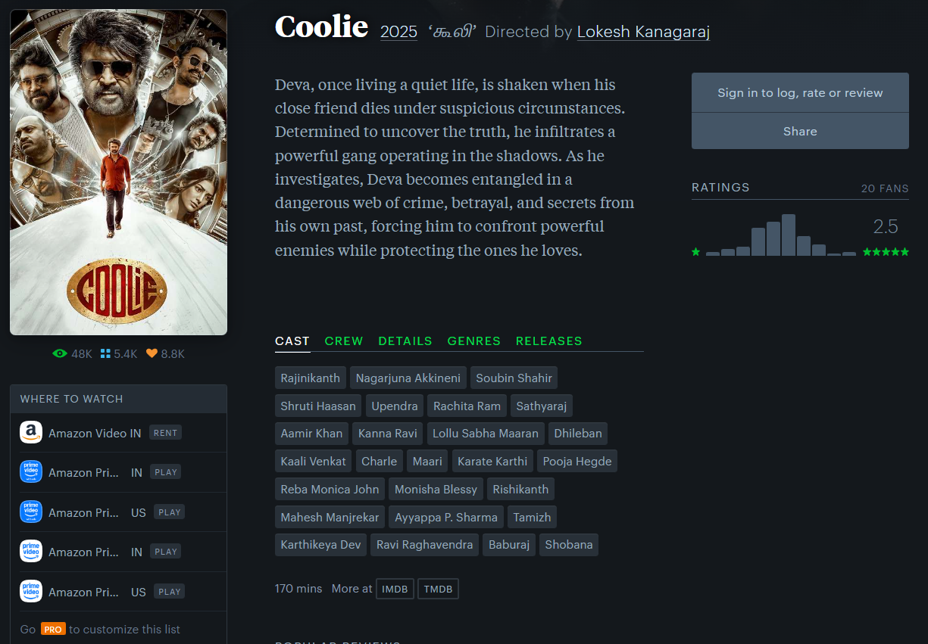

Data Collection Strategy
Step 1: Extracting link of every movie page using selenium, requests and BeautifulSoup module
Step 2: Lopping through each link
Step 3: Extracting data from movie page using requests and BeautifulSoup module
Step 4: Storing Raw Data Into Data Frame using Pandas module
Home Page
Movie Page

Slide 7
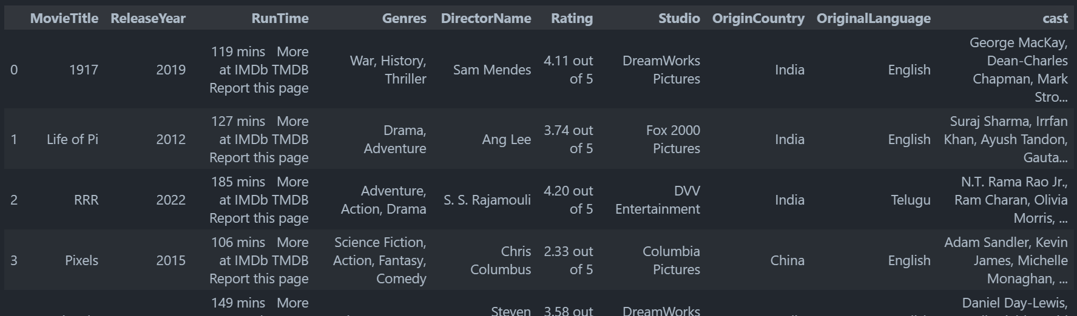
Features Extracted
Sr No | Feature | Total Non null Values | Data Type
1 | MovieTitle | 720 | Object
2 | ReleaseYear | 720 | Int64
3 | RunTime | 720 | Object
4 | Genres | 719 | Object
5 | DirectorName | 720 | Object
6 | Rating | 720 | Object
7 | Studio | 713 | Object
8 | OriginCountry | 720 | Object
9 | OriginalLanguage | 720 | Object
10 | cast | 718 | Object
Total 720 entries from 0 to 719
Initial Table View

Slide 8
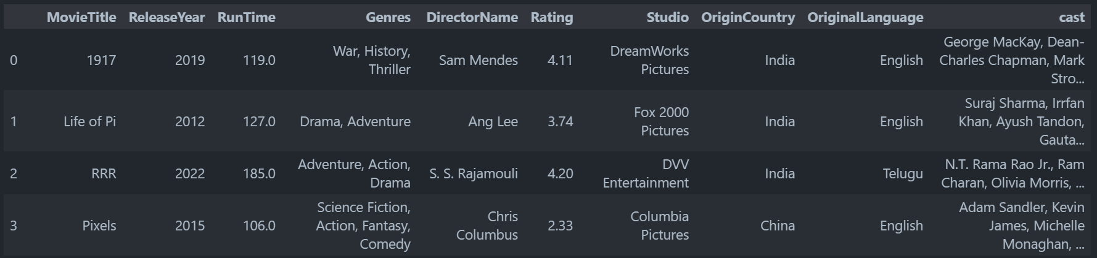
Data Cleaning
Sr No | Feature | Total Non null Values | Data Type
1 | MovieTitle | 710 | Object
2 | ReleaseYear | 710 | Int64
3 | RunTime | 710 | Float64
4 | Genres | 710 | Object
5 | DirectorName | 710 | Object
6 | Rating | 710 | Float64
7 | Studio | 710 | Object
8 | OriginCountry | 710 | Object
9 | OriginalLanguage | 710 | Object
10 | cast | 710 | Object
Total 710 entries from 0 to 709
Cleaned Table View

Slide 9

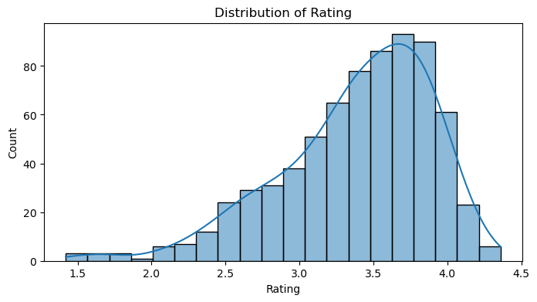
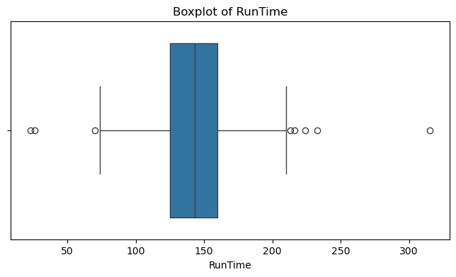

Univariate Analysis
Analysis:
⭐ Standard rating: ~3.5-4.0 stars (2-hour equivalent of quality consensus)
📊 Tight clustering = quality standardization across the film industry
📉 Outliers = diverse film formats included (documentaries, short films, experimental cinema with distinct rating profiles)
🔝 Few ultra-high ratings (4.2+ stars) = rare exception (only top-tier acclaimed films achieve near-perfect scores)
⭐ Majority cluster between 3.0-4.0 stars = industry consensus toward positive reception and audience satisfaction
📊 Tight distribution around 3.5-4.0 = standardized quality expectations and consistent audience approval
📉 Right-skewed with long left tail = diverse film formats (documentaries, experimental) included with niche ratings
🔝 Ratings above 4.0 are rare = exceptional reviews form a small segment, creating premium tier differentiation
⚠️ Very few films below 2.5 stars = market filters out low-quality content before widespread circulation

Slide 10
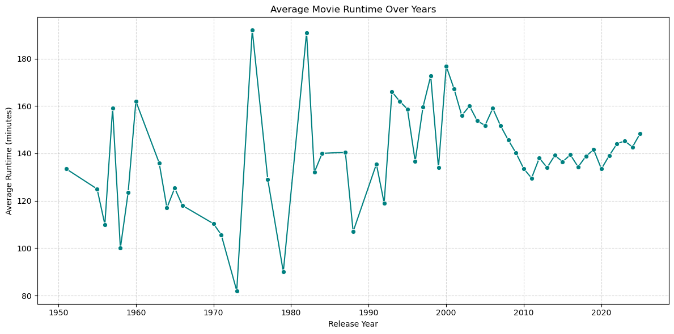
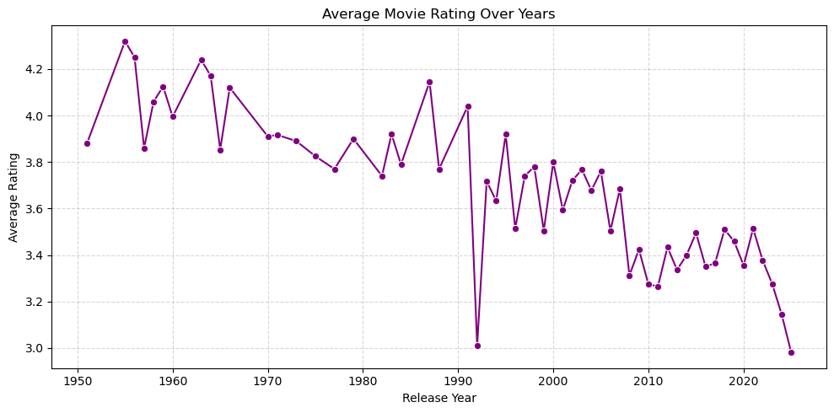
Bivariate Analysis
Analysis:
📉 Ratings: Steady decline from 4.3 → 3.0 (1950 → 2025)
📊 Runtime: Volatile → Stabilized around 140 min post-2000
🔄 No positive correlation: Longer films ≠ Better ratings
🎬 Modern challenge: Standardized length but declining satisfaction

Slide 11
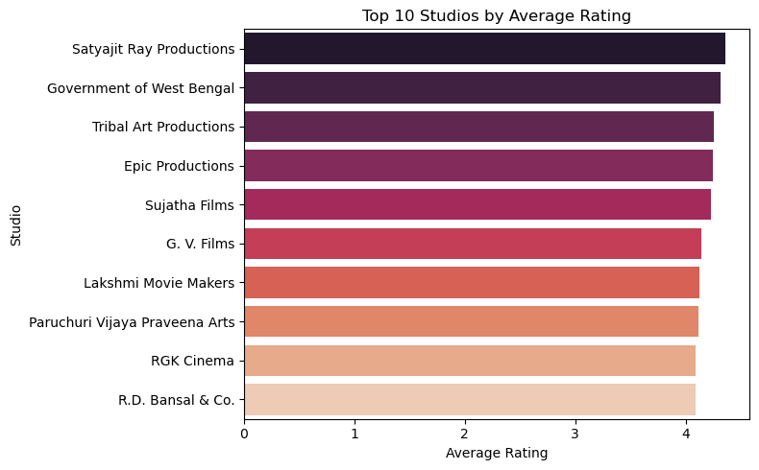
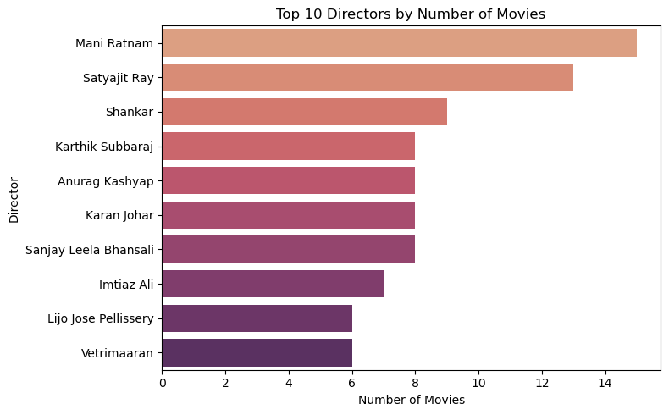
Bivariate Analysis
Analysis:
🏅 Satyajit Ray Productions stands out as the highest-rated studio, setting a strong benchmark for film quality and audience satisfaction.
🏛 Government of West Bengal and Tribal Art Productions secure top spots, indicating strong cultural and artistic contributions to cinema.
🎯 For aspiring filmmakers, partnering with these studios could increase the likelihood of both critical acclaim and higher audience ratings.
🎬 Mani Ratnam and Satyajit Ray are the most prolific directors, each with more than 12 films, showcasing a legacy of creativity and influence.
🚀 Diverse representation: The list spans different generations and filmmaking styles, reflecting the broad spectrum of Indian cinema’s creative leadership.
💡 High output by these directors signals sustained success and audience trust in their storytelling and vision.

Slide 12
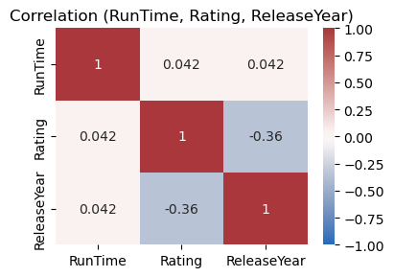
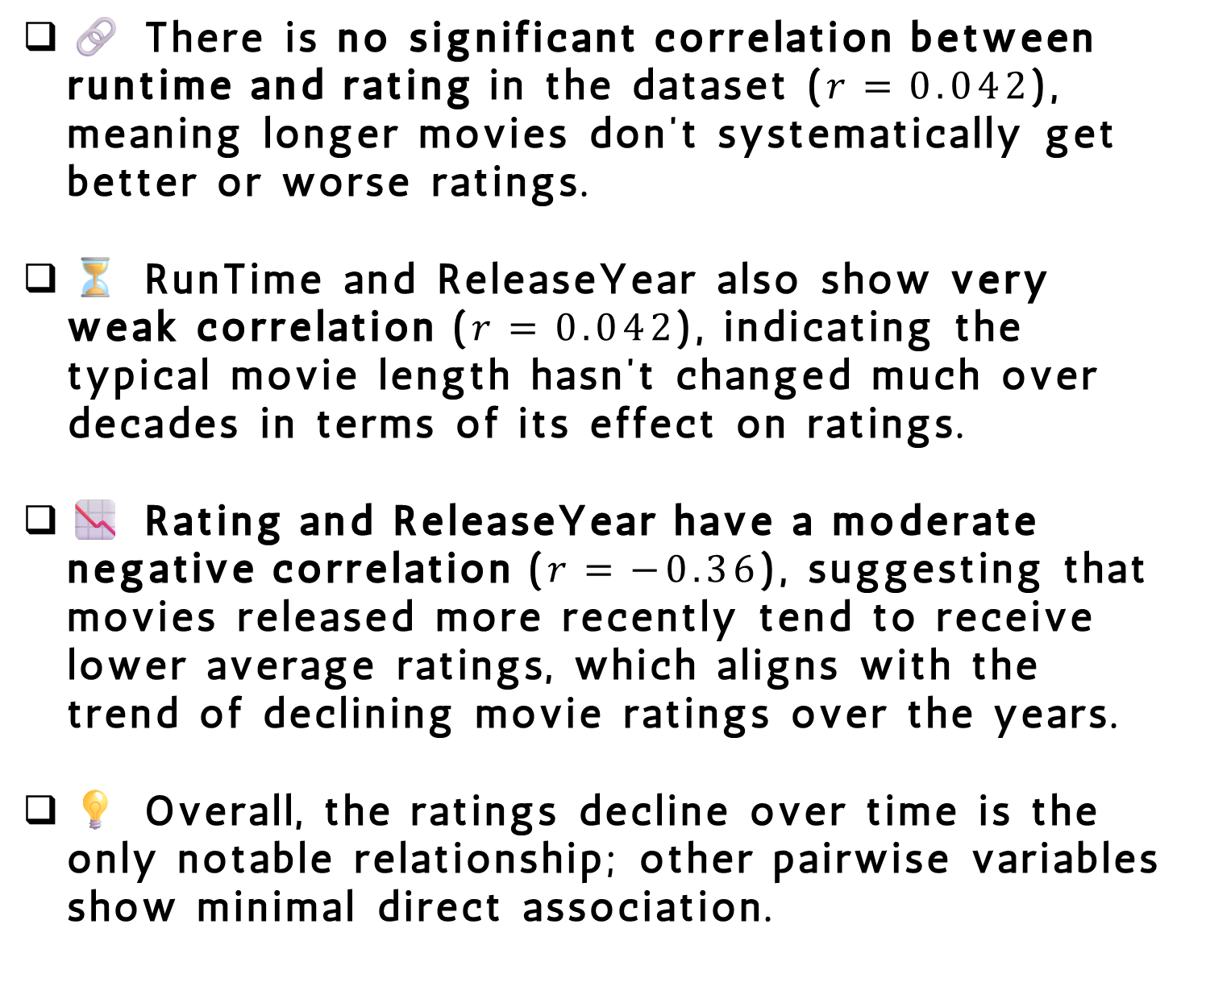
Multivariate Analysis
Analysis:
🔗 There is no significant correlation between runtime and rating in the dataset ($r=0.042$), meaning longer movies don’t systematically get better or worse ratings.
⏳ RunTime and ReleaseYear also show very weak correlation ($r=0.042$), indicating the typical movie length hasn’t changed much over decades in terms of its effect on ratings.
📉 Rating and ReleaseYear have a moderate negative correlation ($r=−0.36$), suggesting that movies released more recently tend to receive lower average ratings, which aligns with the trend of declining movie ratings over the years.
💡 Overall, the ratings decline over time is the only notable relationship; other pairwise variables show minimal direct association.

Slide 13
Conclusion
📉 Ratings Decline: Average movie ratings have steadily fallen from 4.3 (1950s) to 3.0 (2025), indicating shifting audience standards or critical fatigue.
⏱️ Runtime Stabilization: Movie lengths were highly volatile before 2000 but have now stabilized around 130-150 minutes, reflecting industry standardization.
🔗 Weak Runtime-Rating Link: There is virtually no correlation (r=0.042) between film length and audience ratings, proving longer films don't guarantee better reception.
📊 Recency Effect: Newer films receive lower ratings (r=-0.36 with release year), suggesting either changing viewer expectations or improved rating transparency over time.
🏆 Studio & Director Hierarchy: Top studios (Satyajit Ray Productions) and prolific directors (Mani Ratnam, Satyajit Ray) set quality benchmarks, but output doesn't correlate with ratings.
🎬 Quality Over Quantity: Success in cinema depends on storytelling innovation and content quality rather than production volume or extended runtimes.
💡 Industry Insight: The film industry must balance standardized practices with creative differentiation to maintain audience engagement in an evolving media landscape.

Slide 14

the
end

